Slide 1
Deciphering nature's secrets through bioinformatics: merging biology with data
160121733164-Meghanath
160121733166-Vivek
160121733172-Harshith
160121733175-Likhith

Slide 2


Introduction to Bioinformatics
Definition of Bioinformatics
Bioinformatics is the interdisciplinary field that combines biology, computer science, and information technology to analyze and interpret biological data.
It plays a crucial role in advancing our understanding of genomics, proteomics, and other areas of modern biology.

Slide 3

Fundamentals of Molecular Biology
Molecular biology delves into the fundamental building blocks of life - DNA, RNA, and proteins. It explores how genetic information is stored, expressed, and replicated within cells. This field examines the complex molecular mechanisms that drive essential biological processes like gene expression, DNA replication, and protein synthesis.
Understanding the molecular structures of living organisms is crucial for advancing fields like genetics, biotechnology, and bioinformatics. Researchers leverage these insights to develop innovative therapies, engineer novel genetically modified organisms, and unravel the mysteries of complex biological systems.

Slide 4

Emergence of BioInformatics:
Complexity Challenge: Traditional methods struggled to handle the complexity of biological systems, which operate at multiple levels.
Interdisciplinary Fusion: Bioinformatics fused biology with computer science, math, and stats, offering computational tools to analyze biological data.
Predictive Power: It provided predictive models to understand biological systems' dynamics and behaviors.
Impactful Applications: Bioinformatics revolutionized drug discovery, disease research, and personalized medicine by analyzing genomic, transcriptomic, and proteomic data.

Slide 5





Bioinformatics Applications
Medicine
1
Drug discovery, personalized medicine, disease diagnosis
2
Agriculture
Crop improvement, livestock breeding, pest control
3
Environment
Biodiversity conservation, natural resource management
Forensics
4
DNA profiling, pathogen identification, wildlife forensics
Research
5
Genomics, proteomics, systems biology, evolutionary studies

Slide 6
Key Components of Bioinformatics
Sequence Analysis
Structural Bioinformatics
Genomic Analysis
Phylogenetics
metagenomics

Slide 7
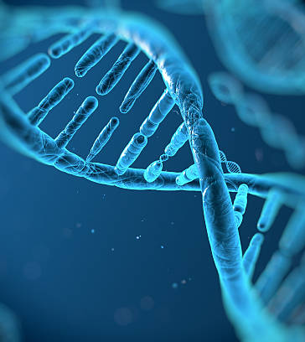
Sequence Analysis
Definition: Sequence analysis involves comparing DNA, RNA, or protein sequences to understand genetic variation, gene function, and evolutionary relationships.
Importance: It helps identify genes, regulatory elements, and genetic variations crucial for understanding traits, diseases, and evolutionary relationships.
Tools and Techniques: Bioinformatics tools like BLAST (Basic Local Alignment Search Tool) and ClustalW are used for sequence alignment and comparison.
Applications: Sequence analysis is used in genetics, evolutionary biology, biotechnology, and personalized medicine for tasks such as gene discovery, disease diagnosis, and drug design.

Slide 8
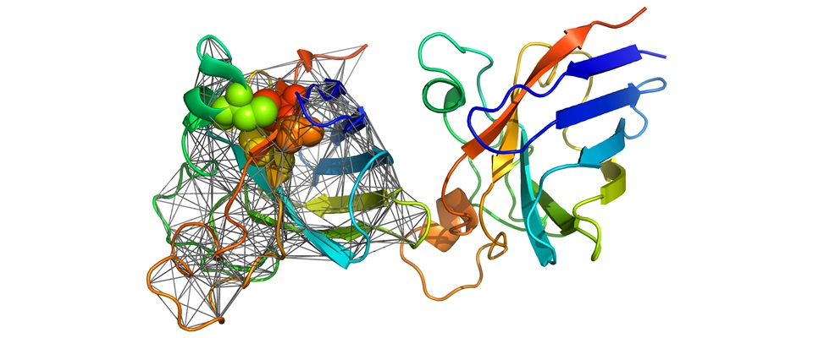
Structural Bioinformatics
Definition: Structural bioinformatics focuses on predicting and analyzing the three-dimensional structures of biological molecules, such as proteins and nucleic acids.
Importance: It helps understand protein function, predict ligand binding sites, and design novel drugs.
Methods: Techniques like homology modeling, molecular docking, and molecular dynamics simulations are used for protein structure prediction and analysis.
Applications: Structural bioinformatics is applied in drug discovery, protein engineering, and understanding the molecular basis of diseases.

Slide 9
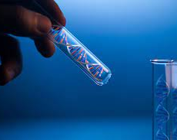
Genomic Analysis
Definition: Genomic analysis involves the study of entire genomes to identify genes, regulatory elements, and genetic variations.
Importance: It provides insights into the genetic basis of traits, diseases, and evolutionary relationships.
Techniques: Genome sequencing techniques, such as Sanger sequencing and next-generation sequencing (NGS), are used to sequence and analyze DNA.
Applications: Genomic analysis is used in personalized medicine, agriculture, evolutionary biology, and conservation genetics

Slide 10
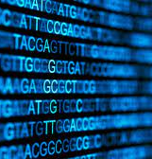
Phylogenetics
Definition: Phylogenetics is the study of evolutionary relationships among organisms based on genetic data.
Importance: It helps reconstruct the evolutionary history and relatedness of species or groups of organisms.
Methods: Phylogenetic analysis involves constructing phylogenetic trees using computational algorithms and models.
Applications: Phylogenetics is applied in evolutionary biology, biodiversity conservation, and understanding the spread of infectious diseases.

Slide 11
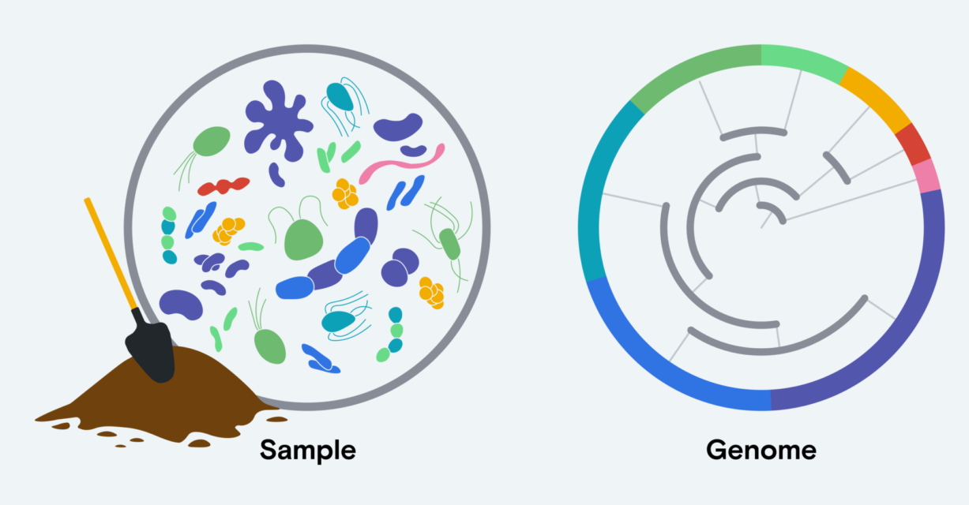
Metagenomics
Definition: Metagenomics is the study of microbial communities in environmental samples, allowing for the analysis of genetic material from multiple organisms simultaneously.
Importance: It provides insights into microbial diversity, function, and interactions within ecosystems.
Methods: Metagenomic analysis involves sequencing DNA directly from environmental samples, followed by computational analysis to characterize microbial communities.
Applications: Metagenomics is used in environmental microbiology, biotechnology, and human health, including studying the human microbiome and environmental remediation.

Slide 12

Conclusion
The emergence of bioinformatics marks a pivotal moment in biological research, enabling scientists to navigate the vast seas of biological data with unprecedented precision and insight. By integrating computational methods with biological principles, bioinformatics has revolutionized our understanding of complex biological systems and accelerated discoveries in fields such as drug development, disease research, and personalized medicine. As we continue to advance in technology and computational techniques, bioinformatics will remain indispensable in unraveling the mysteries of life and driving innovation in biomedical sciences.

Slide 13
ThankYou

